Slide 1
XV6 Introduction
Kowshic Roy

Slide 2
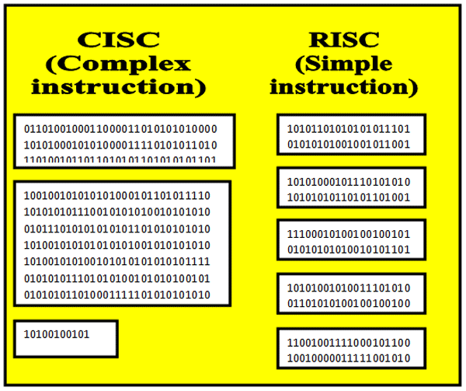
xv6 origin
A teaching OS developed in MIT.
Unix v6
RISC - V

Slide 3
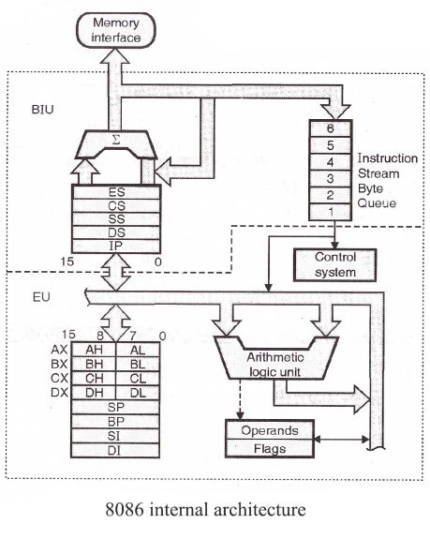
A machine
How many bit?

Slide 4
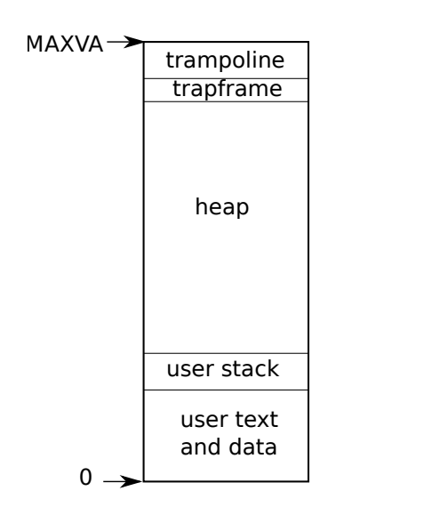
A process

Slide 5
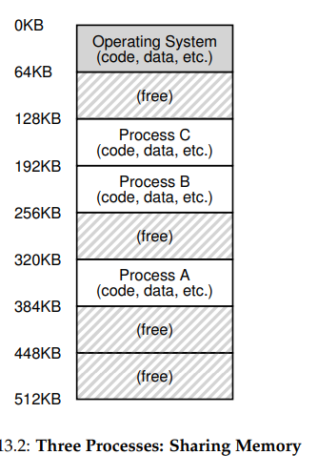
Why we need OS?
A machine that is accessed by all of you
Picture oa ram with 64 KB
Easy snooping by providing physical address.
Extra malloc to hijack other’s memory address.

Slide 6
Assembly Code
/* Type your code here, or load an example. */ int square(int num) { return num * num; } | square: push rbp mov rbp, rsp mov DWORD PTR [rbp-4], edi mov eax, DWORD PTR [rbp-4] imul eax, eax pop rbp ret
fptr = fopen("filename.txt", "w"); | lui a5,%hi(.LC0) addi a1,a5,%lo(.LC0) lui a5,%hi(.LC1) addi a0,a5,%lo(.LC1) call fopen mv a5,a0 sw a5,-20(s0)

Slide 7
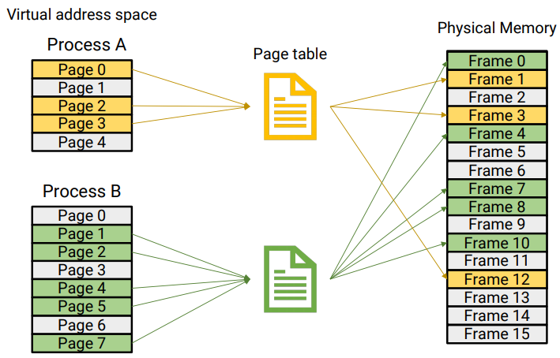
Virtual Memory

Slide 8
Traps
System Calls
Exceptions
Interrupts
User Space | Kernel Space
push rbp mov rbp, rsp mov DWORD PTR [rbp-4], edi mov eax, DWORD PTR [rbp-4] imul eax, eax pop rbp ret | . . . sbrk: push rbp mov rbp, rsp . . .

Slide 9
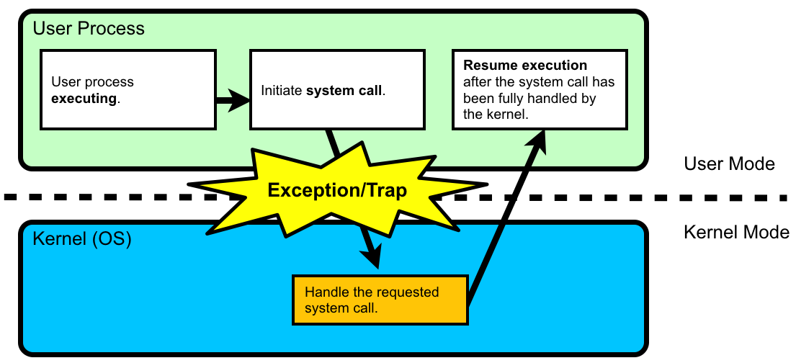
System call mechanism

Slide 10
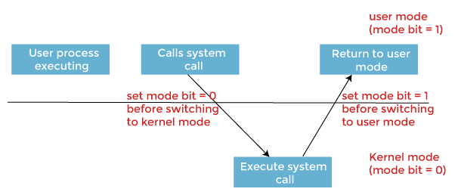
System call mechanism

Slide 11
Trap table
System call Name | ID | Memory Address
Fork | 0 | 0xFFFFF…
Open | 5 | 0x03FFF….

Slide 12
A machine
How many bit?

Slide 13
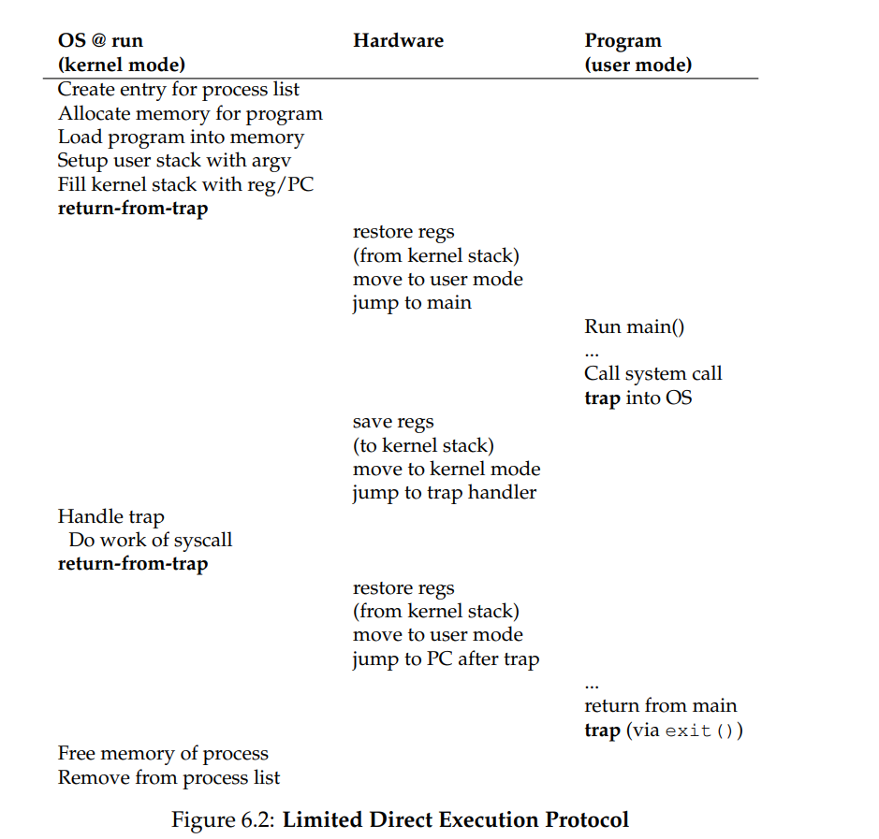

Slide 14
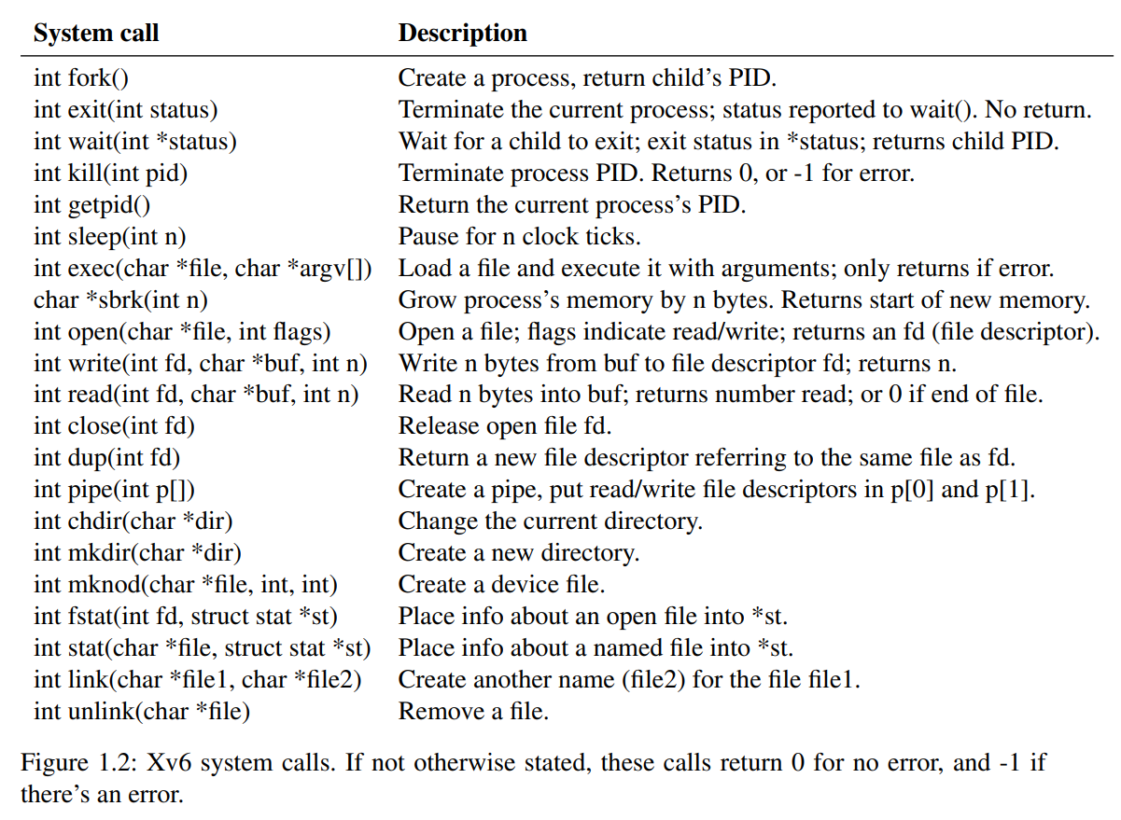
System calls in xv6

Slide 15
And many mores we will add …

